Slide 1
Django Personal portfolio
Technical specifications

Slide 2

Agenda
Concept
Project management
Implementation plan
Future work

Slide 3

Motivation
Demonstrate ability to program by creating a website CV. Use this as an opportunity to build skills in web design using the Django framework. Create a platform to self-advertise.

Slide 4
Concept
Dashboard and webpage mock-ups

Slide 5
Dashboard

Slide 6
Webpage 1: ?

Slide 7
Team
Me
Myself
I

Slide 8
Project management

Slide 9
Timeline
Title
To start a presentation, go to the Slide Show tab, and select From Beginning.
Title
To display Presenter view, in Slide Show view, on the control bar at the bottom left select the three dots, and then Show Presenter View.
Title
During your presentation, the speaker notes are visible on your monitor, but aren't visible to the audience.
Title
The Notes pane is a box that appears below each slide. Tap it to add notes.
Title
If you don’t see the Notes pane or it is completely minimised, click Notes on the task bar across the bottom of the PowerPoint window.

Slide 10
Version control
GitHub
Repo: Portfolio

Slide 11
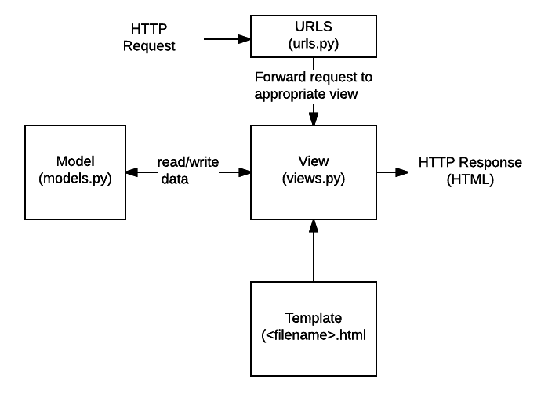
Django workflow

Slide 12
Implementation plan

Slide 13
Solution architecture
Django project: portfolio_django
Templates: portfolio_django\templates
Content/pages
CV: personal details, education, experience, interests
Projects: Title, detail, employeer, client, date (beware of disclosing IP)
Models: Interactive python models for…
Services: Consulting and product development for… and in…
Contact: Get in contact (could be part of base)
Only one app needed:
portfolio_content

Slide 14
Base template html
MVP
Future work
{% block page_content %}{% endblock %}
<script src="https://code.jquery.com/jquery-3.3.1.slim.min.js" integrity="sha384-q8i/X+965DzO0rT7abK41JStQIAqVgRVzpbzo5smXKp4YfRvH+8abtTE1Pi6jizo" crossorigin="anonymous"></script>
<script src="https://cdnjs.cloudflare.com/ajax/libs/popper.js/1.14.3/umd/popper.min.js" integrity="sha384-ZMP7rVo3mIykV+2+9J3UJ46jBk0WLaUAdn689aCwoqbBJiSnjAK/l8WvCWPIPm49" crossorigin="anonymous"></script>
<script src="https://stackpath.bootstrapcdn.com/bootstrap/4.1.3/js/bootstrap.min.js" integrity="sha384-ChfqqxuZUCnJSK3+MXmPNIyE6ZbWh2IMqE241rYiqJxyMiZ6OW/JmZQ5stwEULTy" crossorigin="anonymous"></script>
Add ????

Slide 15



Summary
With PowerPoint, you can create presentations and share your work with others, wherever they are. Type the text you want here to get started. You can also add images, art, and videos on this template. Save to OneDrive and access your presentations from your computer, tablet, or phone.

Slide 16




End of document
Laurence Dodd
Email address
Website

